Slide 1
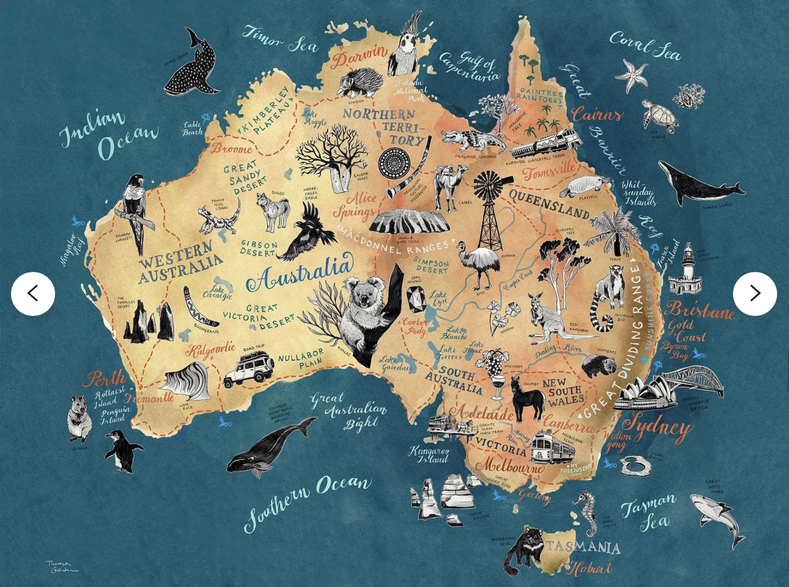

TRAVEL IN AUSTRALIA
SECOND MODULE
FOURTH MODULE
FIRST MODULE
THIRD MODULE

Slide 2
An in-depth analysis of international passenger movement
International Travel Trends to and from Australia (2000-2022)
Presenter: Joanna Kozak

Slide 3
The dataset includes information on passenger movement between Australian and foreign ports in years 2000-2022.
The analysis focuses on understanding top destinations, seasonal patterns, and identifying popular Australian ports.

Slide 4
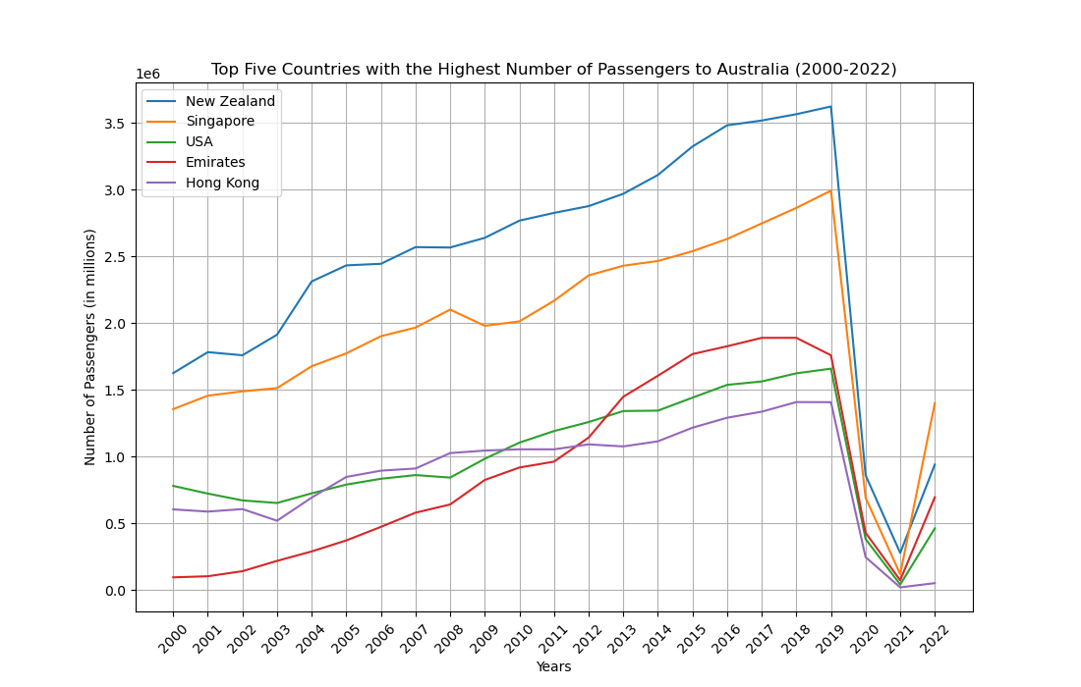
Top Five Countries In
INSERT GRAPH

Slide 5
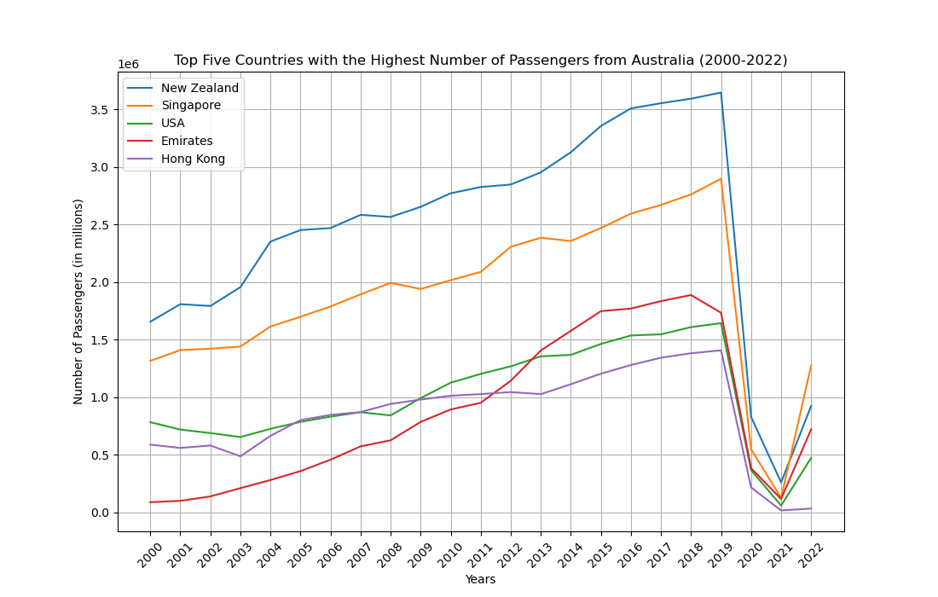
Top Five Countries Out
INSERT GRAPH

Slide 6
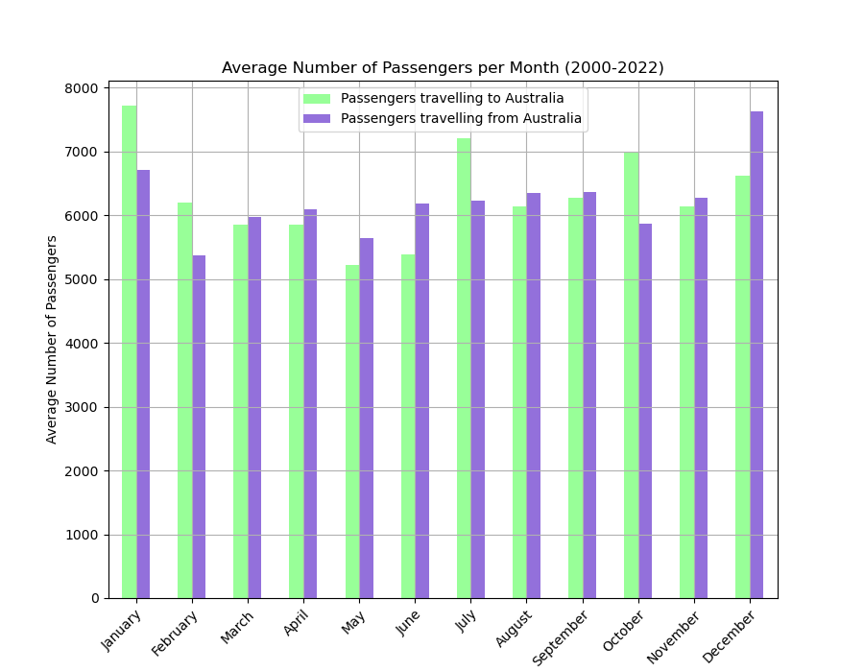
Seasonal Patterns
INSERT GRAPH

Slide 7
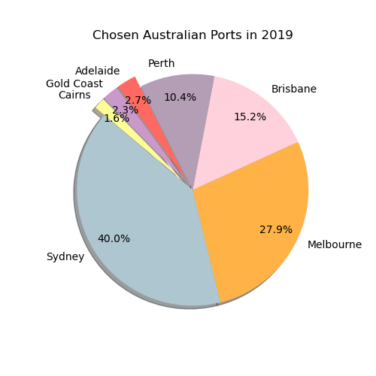
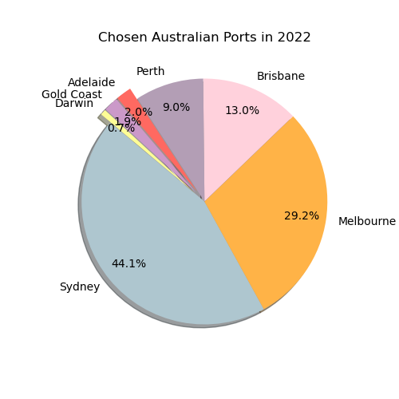
Most Popular Australian Ports in 2019 and 2022
INSERT GRAPH

